Slide 2
After this lecture, you will be able to,
Learn about the cloud services and their types.
Explore Software as a Service, Platform as a Service, Infrastructure as a Service.

Slide 3
Cloud Services
Any IT services that are provisioned and accessed from a cloud computing provider.
Incorporates all delivery and service models of cloud computing and related solutions.

Slide 4
Cloud Services
Delivered over the internet and accessible globally from the internet.
Describe how the services delivery is carried out in cloud computing.
Indicate the topological layouts for the cloud computing.
The entities basically correspond to the operational components in cloud computing.

Slide 5
Cloud Services
Cloud services provide great flexibility in provisioning, duplicating and scaling resources to balance the requirements of users, hosted applications and solutions.

Slide 6
Classification of Cloud Services
Two high levels of classifications, namely, Archetypal and Hybrid cloud service models.
Classic or archetypal category pertains to the three original cloud service models,
Software-as-a-Service (SaaS)
Platform-as-a-Service (PaaS)
Infrastructure-as-a-Service (IaaS)

Slide 7
Classic Cloud Service Models
CLOUD COMPUTING
Software-as-a-Service
(Commercial Software Acessibilty)
Infrastructure-as-a-Service
(Acessibilty to Servers, Network Devices, Storage)
Platform-as-a-Service
(Accesibility to information, messaging, integrated services, connectivity etc.)

Slide 8
Hybrid Cloud Service Models
Driven by the need for more flexibility and control on the deployment of their applications, hybrid models emerged.
Consolidation of PaaS and IaaS models.

Slide 9
Hybrid Cloud Service Models
Driven by the need for more flexibility and control on the deployment of their applications, hybrid models emerged.
Consolidation of PaaS and IaaS models.

Slide 10
How to Pick a Cloud Service Model?
Cloud computing is a general term used to identify online delivery of data storage, processing, analytics, and other services, online without being dependent on local hardware.
In order to decide, let’s take a deeper look at the main types of cloud-based services and examine their features and differences.

Slide 11
How to Pick a Cloud Service Model?
Cloud computing is a general term used to identify online delivery of data storage, processing, analytics, and other services, online without being dependent on local hardware.
In order to decide, let’s take a deeper look at the main types of cloud-based services and examine their features and differences.

Slide 12
Infrastructure-as-a-Service (IaaS)
Form of cloud computing that provides virtualized computing resources (Virtual servers with CPU, memory, storage, network access, etc.) over the Internet.

Slide 13
Infrastructure-as-a-Service (IaaS)
IaaS also offers:
Virtual Server Space
Network Connections
Bandwidth
IP addresses
Load Balancers etc

Slide 14
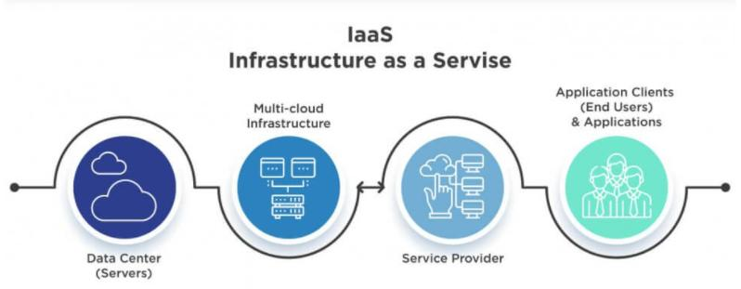
Infrastructure-as-a-Service (IaaS)

Slide 15
Infrastructure-as-a-Service (IaaS)
Physically, the pool of hardware resource is pulled from a multitude of servers and networks usually distributed across numerous data centers, all of which the cloud provider is responsible for maintaining.
Also known as Hardware as a Service (HaaS).

Slide 16
Infrastructure-as-a-Service (IaaS)
Physically, the pool of hardware resource is pulled from a multitude of servers and networks usually distributed across numerous data centers, all of which the cloud provider is responsible for maintaining.
Also known as Hardware as a Service (HaaS).

Slide 17
Salient Features of IaaS
Enterprise Infrastructure
Cloud Hosting
Virtual Data Centers (VDC)

Slide 18
IaaS Categories
IaaS can be obtained as:
Public or
Private infrastructure or
Combination of both

Slide 19
Advantages of IaaS
Scalability.
No Investment in Hardware.
Utility Style Costing.
Location Independence.
Physical Security of Data Centre Locations.
No Single Point of Failure.

Slide 20
IaaS- Appropriate Uses
IaaS is useful in the following situations:
Where Demand is Very Volatile- any time there are significant spikes and troughs in terms of demand on the infrastructure amazon.in, snapdeal, flipkart- during festival season.
For new enterprise without capital to invest in hardware. Example- entrepreneurs starting on a shoestring budget.

Slide 21
IaaS- Appropriate Uses
IaaS is useful in the following situations:
Where Demand is Very Volatile- any time there are significant spikes and troughs in terms of demand on the infrastructure amazon.in, snapdeal, flipkart- during festival season.
For new enterprise without capital to invest in hardware. Example- entrepreneurs starting on a shoestring budget.

Slide 22
IaaS- Appropriate Uses
Where the enterprise is growing rapidly and scaling hardware would be problematic. Example- A company that experience huge success immediately.
Where the enterprise is growing rapidly and scaling hardware would be problematic. Example- A company that experience huge success immediately - animato, pinterest.
For specific line of business, trial or temporary infrastructural needs.

Slide 23
IaaS- Appropriate Uses
Where the enterprise is growing rapidly and scaling hardware would be problematic. Example- A company that experience huge success immediately.
Where the enterprise is growing rapidly and scaling hardware would be problematic. Example- A company that experience huge success immediately - animato, pinterest.
For specific line of business, trial or temporary infrastructural needs.

Slide 24
IaaS- Appropriate Uses
Where the enterprise is growing rapidly and scaling hardware would be problematic. Example- A company that experience huge success immediately.
Where the enterprise is growing rapidly and scaling hardware would be problematic. Example- A company that experience huge success immediately - animato, pinterest.
For specific line of business, trial or temporary infrastructural needs.

Slide 25
Examples of IaaS
Amazon Web Services
Microsoft Azure
IBM Infrastructure
Google Cloud Infrastructure

Slide 26
Examples of IaaS
Amazon Web Services
Microsoft Azure
IBM Infrastructure
Google Cloud Infrastructure

Slide 27
Examples of IaaS
Amazon Web Services
Microsoft Azure
IBM Infrastructure
Google Cloud Infrastructure

Slide 28
Examples of IaaS
Amazon Web Services
Microsoft Azure
IBM Infrastructure
Google Cloud Infrastructure

Slide 29
Infrastructure-as-a-Service (IaaS)
Popular IaaS offerings like Rackspace Open Cloud, Amazon EC2, IBM SoftLayer, and Google’s Compute Engine (GCE) are silently powering a huge portion of the backbone of the internet, whether users realize it or not.
Open-source options include OpenStack and Apache’s CloudStack.

Slide 30
Infrastructure-as-a-Service (IaaS)
Popular IaaS offerings like Rackspace Open Cloud, Amazon EC2, IBM SoftLayer, and Google’s Compute Engine (GCE) are silently powering a huge portion of the backbone of the internet, whether users realize it or not.
Open-source options include OpenStack and Apache’s CloudStack.

Slide 31
Platform-as-a-Service (PaaS)
PaaS is a category of cloud computing service that provides a platform and environment to allow developers to build applications and services over the internet.
PaaS services are hosted in the cloud and accessed by users simply via their web browser.

Slide 32
Platform-as-a-Service (PaaS)
PaaS is a category of cloud computing service that provides a platform and environment to allow developers to build applications and services over the internet.
PaaS services are hosted in the cloud and accessed by users simply via their web browser.

Slide 33
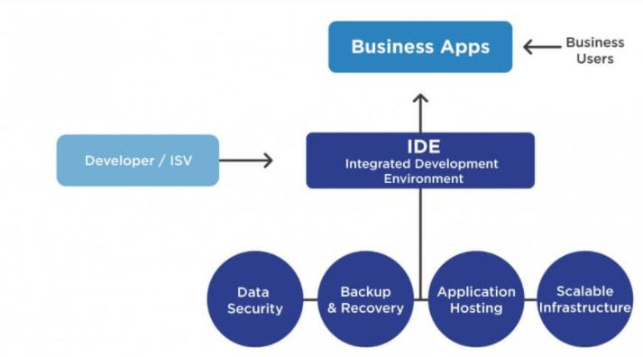
Platform-as-a-Service (PaaS)

Slide 34
Platform-as-a-Service (PaaS)
PaaS is expected to grow by more than 3,000% by 2026.
From $1.78b to $68.38b, more than double SaaS, the expected growth during the same period.

Slide 35
Platform-as-a-Service (PaaS)
PaaS is expected to grow by more than 3,000% by 2026.
From $1.78b to $68.38b, more than double SaaS, the expected growth during the same period.

Slide 36
Platform-as-a-Service (PaaS)
Prime examples include Amazon AWS, Salesforce Platform, Azure from Microsoft and Google App Engine. For those looking for Open Source PaaS platforms, OpenShift Origin, OpenPaaS and Cloud Foundry are probably your best options.

Slide 37
PaaS Goals
Create an abstracted environment that supports an efficient, cost-effective, and repeatable process for the creation and deployment of high-quality applications.

Slide 38
PaaS Goals
Focus on Development, not Ops
Programmers’ development environment
Presentation layer: HTML, CSS, JavaScript
Control layer: Web Server code
Data layer: Data Model
Optionally, analytics

Slide 39
PaaS Goals
Ops below
• Made visible through a web interface
Operating system
File system
User authentication
Utilities (cron, etc.)
Logs
Database maintenance, backups, etc.

Slide 40
Platform-as-a-Service (PaaS) Offerings
PaaS providers can assist developers from the conception of their original ideas to the creation of applications, and through to testing and deployment. This is all achieved in a managed mechanism.
As with most cloud offerings, PaaS services are generally paid for on a subscription basis, with clients ultimately paying just for what they use.

Slide 41
Platform-as-a-Service (PaaS) Offerings
PaaS providers can assist developers from the conception of their original ideas to the creation of applications, and through to testing and deployment. This is all achieved in a managed mechanism.
As with most cloud offerings, PaaS services are generally paid for on a subscription basis, with clients ultimately paying just for what they use.

Slide 42
Platform-as-a-Service (PaaS) Offerings
Operating System
Server-side Scripting Environment
Coding Environment
Database Management System
Server Software
Support
Storage
Network Access
Tools for Design and Development
Hosting

Slide 43
How PaaS Works
PaaS allows users to create software applications using tools supplied by the provider.
PaaS services can consist of preconfigured features that customers can subscribe to; they can choose to include the features that meet their requirements while discarding those that do not.

Slide 44
How PaaS Works
PaaS allows users to create software applications using tools supplied by the provider.
PaaS services can consist of preconfigured features that customers can subscribe to; they can choose to include the features that meet their requirements while discarding those that do not.

Slide 45
How PaaS Works
The infrastructure and applications are managed for customers and support is available.
Services are constantly updated, with existing features upgraded and additional features added.

Slide 46
How PaaS Works
The infrastructure and applications are managed for customers and support is available.
Services are constantly updated, with existing features upgraded and additional features added.

Slide 47
Advantages of PaaS
Users don’t Need to Invest in Physical Infrastructure
Makes development possible for ‘non-experts’
Flexibility
Adaptability
Teams in various locations can work together
Security

Slide 48
Advantages of PaaS
Users don’t Need to Invest in Physical Infrastructure
Makes development possible for ‘non-experts’
Flexibility
Adaptability
Teams in various locations can work together
Security

Slide 49
Advantages of PaaS
Users don’t Need to Invest in Physical Infrastructure
Makes development possible for ‘non-experts’
Flexibility
Adaptability
Teams in various locations can work together
Security

Slide 50
Advantages of PaaS
Users don’t Need to Invest in Physical Infrastructure
Makes development possible for ‘non-experts’
Flexibility
Adaptability
Teams in various locations can work together
Security

Slide 51
Advantages of PaaS
Users don’t Need to Invest in Physical Infrastructure
Makes development possible for ‘non-experts’
Flexibility
Adaptability
Teams in various locations can work together
Security

Slide 52
Advantages of PaaS
Users don’t Need to Invest in Physical Infrastructure
Makes development possible for ‘non-experts’
Flexibility
Adaptability
Teams in various locations can work together
Security

Slide 53
Examples of PaaS
AWS Elastic Beanstalk
Apache Stratos
Magento Commerce Cloud

Slide 54
Examples of PaaS
AWS Elastic Beanstalk
Apache Stratos
Magento Commerce Cloud

Slide 55
Examples of PaaS
AWS Elastic Beanstalk
Apache Stratos
Magento Commerce Cloud

Slide 56
Software-as-a-Service (SaaS)
Describes any cloud service where consumers are able to access software applications over the internet.
Applications are hosted in “the cloud” and can be used for a wide range of tasks for both individuals and organizations.

Slide 57
Software-as-a-Service (SaaS)
Describes any cloud service where consumers are able to access software applications over the internet.
Applications are hosted in “the cloud” and can be used for a wide range of tasks for both individuals and organizations.

Slide 58
Software-as-a-Service (SaaS)
Enterprise users are able to use applications for a range of needs, including accounting and invoicing, tracking sales, planning, performance monitoring and communications (including webmail and instant messaging).

Slide 59
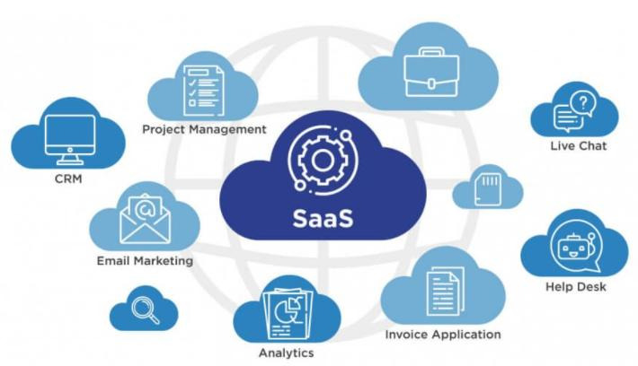
Software-as-a-Service (SaaS)

Slide 60
Advantages of SaaS
No Additional Hardware Costs
No Initial Setup Costs
Pay for What You Use
Usage is Scalable
Updates are Automated
Cross-Device Compatibility
Accessible from Any Location
Applications can be Customized and White labelled

Slide 61
Advantages of SaaS
No Additional Hardware Costs
No Initial Setup Costs
Pay for What You Use
Usage is Scalable
Updates are Automated
Cross-Device Compatibility
Accessible from Any Location
Applications can be Customized and White labelled

Slide 62
Advantages of SaaS
No Additional Hardware Costs
No Initial Setup Costs
Pay for What You Use
Usage is Scalable
Updates are Automated
Cross-Device Compatibility
Accessible from Any Location
Applications can be Customized and White labelled

Slide 63
Advantages of SaaS
No Additional Hardware Costs
No Initial Setup Costs
Pay for What You Use
Usage is Scalable
Updates are Automated
Cross-Device Compatibility
Accessible from Any Location
Applications can be Customized and White labelled

Slide 64
Advantages of SaaS
No Additional Hardware Costs
No Initial Setup Costs
Pay for What You Use
Usage is Scalable
Updates are Automated
Cross-Device Compatibility
Accessible from Any Location
Applications can be Customized and White labelled

Slide 65
Advantages of SaaS
No Additional Hardware Costs
No Initial Setup Costs
Pay for What You Use
Usage is Scalable
Updates are Automated
Cross-Device Compatibility
Accessible from Any Location
Applications can be Customized and White labelled

Slide 66
Advantages of SaaS
No Additional Hardware Costs
No Initial Setup Costs
Pay for What You Use
Usage is Scalable
Updates are Automated
Cross-Device Compatibility
Accessible from Any Location
Applications can be Customized and White labelled

Slide 67
Advantages of SaaS
No Additional Hardware Costs
No Initial Setup Costs
Pay for What You Use
Usage is Scalable
Updates are Automated
Cross-Device Compatibility
Accessible from Any Location
Applications can be Customized and White labelled

Slide 68
Examples of SaaS
Google’s G Suite
Microsoft Office 365
Salesforce

Slide 69
Examples of SaaS
Google’s G Suite
Microsoft Office 365
Salesforce

Slide 70
Examples of SaaS
Google’s G Suite
Microsoft Office 365
Salesforce

Slide 71
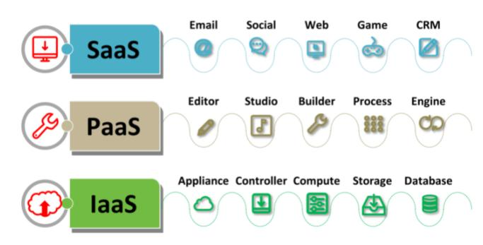
Summarization of Three Cloud Service Models

Slide 72
Difference Between IaaS, PaaS, and SaaS
IaaS | PaaS | SaaS
Provides a virtual data center to store information and create platforms for app development, testing, & deployment. | It provides virtual platforms and tools to create, test, and deploy apps. | Provides web software and apps to complete business tasks.
Provides access to resources such as virtual machines, virtual storage etc. | Provides runtime environments & deployment tools for applications. | Provides software as a service to the end-users.
Used by the network architects. | Used by developers. | Used by the end users.
Provides only Infrastructure. | Provides Infrastructure + Platform. | Provides Infrastructure + Platform +Software.

